Slide 1
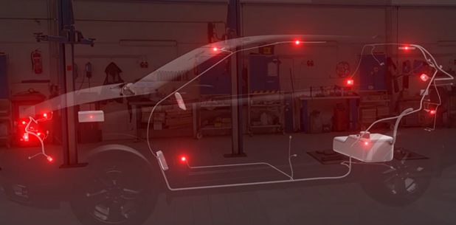
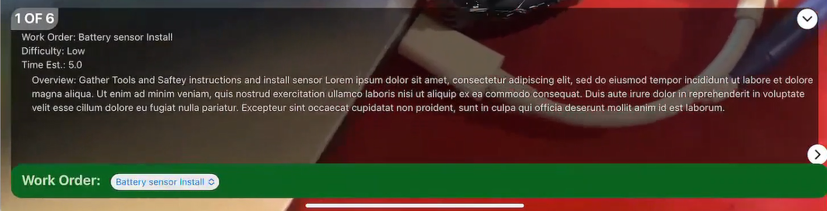
Component locator
Steve Grey-Wilson
12/29/2023

Slide 2
Component locator summary
The component locator example was originally based on an Automotive use model but could address any experience that uses the construct of a Work package that has work instructions, related models and the visual AR requirement of locating and understanding where and what the instructions are.
The architecture requires a data store for Work package definition, models and model targets. The implementation uses Thingworx Data tables, services and Repo as the physical data store.
Additionally, a Vuforia Experience server and View as the mobile app (This solution has not be designed for Hololens although with some work on the UI it could be possible. )

Slide 3






Component locator
Experience Server
Work Instructions
Service requests
Model and Targets Repo

Slide 4
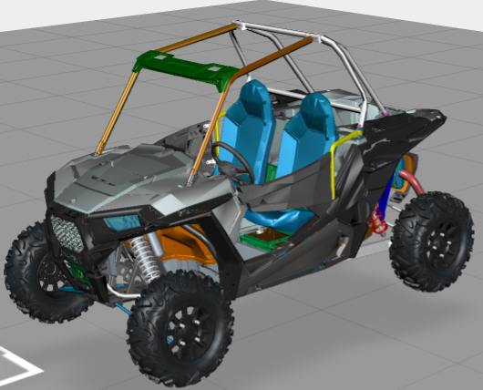
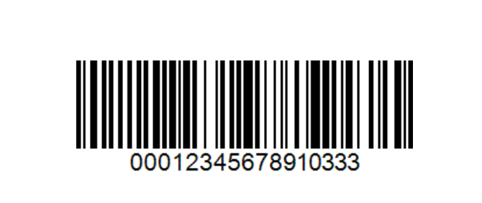
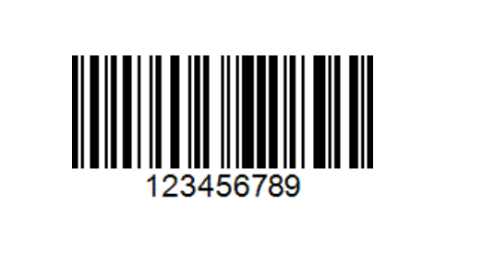
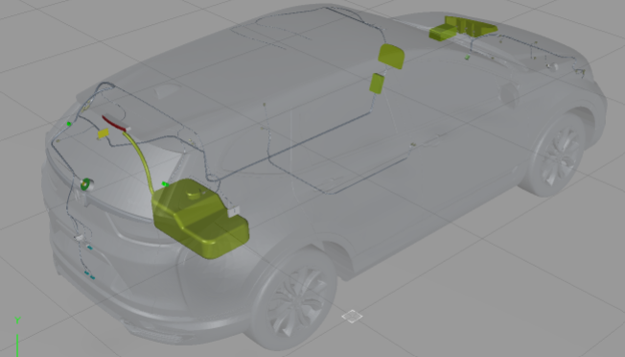




implementation SUMMARY
The components of the Experience are
Barcode or ID to identify the start point (barcode in our case)
A Work Package(s) related to ID
Each Work Package consists of
Work Order summary (step 0)
Work Instruction per step
Affected Parts(models) per step

Slide 5
IMPLEMENT DETAILS
schema
Work Order that binds the VIN and Instructions
AutoARWorkOrder_DT
WorkID (Key)
Title
Overview
Difficulty
Time
VIN
Hero Part Model Target Identifier
AutoARHeroPart_DT
VIN (key)
Folder
MTID
MTDataset
MTGuideView
Model
Work Instruction
AutoARWorkInstruction_DT
WorkID (Key) Identifier
StepNumber (Key)
Label1
Label2
Label3
StepDetail
AffectedPartsID (reference ID)
Related Models in Step
AutoARAffectedParts_DT
AffectedPartID (Key)
MetadataID
MetadataPropertyName
ModelName
DisplayName // redundant maybe this can from the metadata
PartName // redundant maybe this can from the metadata
FileName

Slide 6
IMPLEMENT DETAILS
Create Data
Hero Part Model Target Identifier
AutoARHeroPart_DT
VIN (key)
Folder
MTID
MTDataset
MTGuideView
Model
The VIN is the Vehicle identifier
The Folder is the repo location for the Targets and Affected Items
The MTID is the identifier used within the XML and the Dataset
The MTDataset is the model target data definition
The MTGuideview is the image silhouette presented to the user
The Model is the pvz model as the target model
let crvVin = "123456789";
CreateHeroPart('Crv' , 'crv_outer360', 'crv_outer360', 'crv_outer_GuideView_0000_2.png', 'crv_outer.pvz' , crvVin);
//
Pseudo function

Slide 7
IMPLEMENT DETAILS
schema
Create Data
Work Instruction
AutoARWorkInstruction_DT
WorkID (key)
StepNumber (key)
Label1
Label2
Label3
StepDetail
AffectedPartsID
WorkInstructions are based on WorkID and StepNumber
Label1,2,3 are UI labels that can be populated depending on the requirement on the Instruction (can be blank)
StepDetail provides the detail
Pseudo function
let apDTC_B1028_1 = CreateWi(id,'Please make sure all safety options have been worked through.',1,'Safety');

Slide 8
IMPLEMENT DETAILS
Create Data
Work Order that binds the VIN and Order ID
AutoARWorkOrder_DT
WorkID
Title
Overview
Difficulty
Time
VIN
The Vin defines the vehicle and WorkID’s the actions to be taken
Pseudo function
createWorkOrder
WorkID = 'WIB1028’,
Title ="Rear Window Wiper Motor. As Signal Error" ,
Overview = "Rear Window Wiper Motor (As) Signal Error : If you are troubleshooting multiple DTCs, be sure to follow the instructions in B-CAN System Diagnosis Test Mode A" ,
Difficulty = "Medium" ,
Time = 300,
VIN = 123456789;
//

Slide 9
IMPLEMENT DETAILS
Create Data
Related Models in Step
AutoARAffectedParts_DT
AffectedPartID (key)
MetadataID (key)
MetadataPropertyName
ModelName
DisplayName // redundant maybe this can from the metadata
PartName // redundant maybe this can from the metadata
FileName
Pseudo function
createAffectedPart(apDTC_B1028_1, "/134", "path", "ap_rear_wiper_motor" , "REAR_WIPER_MOTOR.PRT" , "REAR_WIPER_MOTOR.PRT" , "/Crv/AffectedPart/rear_wiper_motor.pvz" );
createAffectedPart(apDTC_B1028_1, "/68/85/@@PV-AUTO-ID@@010", "path", "tailgate_wireharness" , "BUNDLE_1" , "BUNDLE_1" , "/Crv/AffectedPart/tailgate_wireharness.pvz" );
createAffectedPart(apDTC_B1028_1, ":5/134", "path", "ap_underDashFuseRelayBox" , "UNDERDASHFUSERELAYBOX.PRT" , "UNDERDASHFUSERELAYBOX.PRT" , "/Crv/AffectedPart/underDashFuseRelayBox.pvz" );
createAffectedPart(apDTC_B1028_1, "/138", "path", "ap_gauge_control_unit" , "GAUGE_CONTROL_UNIT.PRT" , "GAUGE_CONTROL_UNIT.PRT" , "/Crv/AffectedPart/gauge_control_unit.pvz" );

Slide 10
Work PACKAGE as JSON (this could easily be SXSL, currently we don’t have a sxsl generator as the definition is complex and beyond the scope of this POC)
An array of all models used within the WorkPackage – this is a convenience entry
Title
Overview
Difficulty
Time
WorkID
Models
WorkInstructions {
"StepNumber": "0.0",
"Label1": "Work Order: Rear Window Wiper Motor. As Signal Error",
"Label3": "Time Est.: 1.0",
"Label2": "Difficulty: Medium",
"WorkID": "WIB1028",
"StepDetail": "Overview: Rear Window Wiper Motor (As) Signal Error : If you are troubleshooting multiple DTCs, be sure to follow the instructions in B-CAN System Diagnosis Test Mode A"
},
{
"AffectedPartsID": "3KK4EQN7VU",
"StepNumber": "1.0",
"Label1": "Safety",
"Label2": "",
"Label3": "",
"Models": {
"array": [
{
"path": "/134",
"model": "ap_rear_wiper_motor"
},
"PartsList": [
{
"ModelName": "ap_rear_wiper_motor",
"AffectedPartID": "3KK4EQN7VU",
"FileName": "/Crv/AffectedPart/rear_wiper_motor.pvz",
"MetadataID": "/134",
"source": "demo",
"MetadataPropertyName": "path",
"tags": [],
"PartName": "REAR_WIPER_MOTOR.PRT",
"sourceType": "User",
"DisplayName": "REAR_WIPER_MOTOR.PRT",
"location": {
"latitude": 0,
"longitude": 0,
"elevation": 0
},
"key": "3KK4EQN7VU/134",
"timestamp": "2023-12-20T21:19:02.159Z"
},
This is an array of steps where step zero is a special case (this may need rework as its really a summary entry point of the instructions)
Subsequenent steps have an array of models and a PartsList

Slide 11
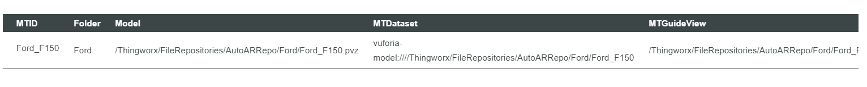
IMPLEMENT DETAILS
Service requests
AutoARServiceHelper
GetHeroData based on Vin number (could be any ID)
Returns
VIN
Folder
MTID
MTDataset
MTGuideView
Model
GetWorkPackage based on Vin number (could be any ID)
Returns JSON (InfoTable)
Package of Work Instructions with steps and related Model.

Slide 12
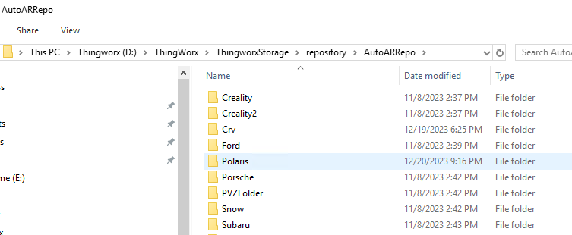
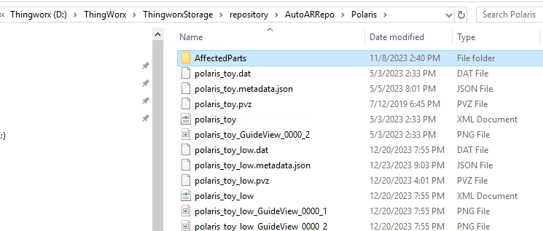
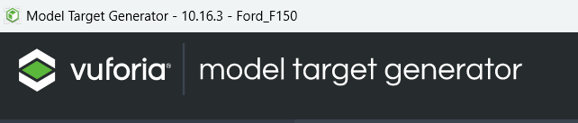
IMPLEMENT DETAILS
Model and Targets Repo
Thing:AutoARRepo
Thingworxs repo that holds
Named Folders
Which contain the
Model Target data
And Affected part models
Use the model target generator and place files in a folder

Slide 13
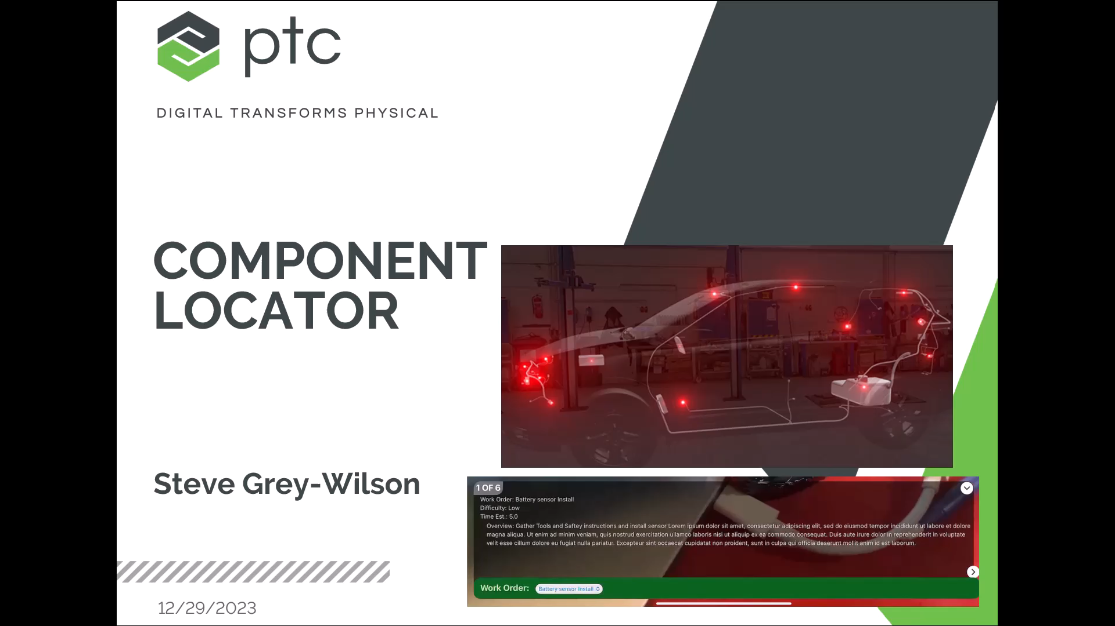
Demonstration on device

Slide 14
Installation
The CreoViewRWHelper extension is required to be installed
https://github.com/mvonhasselbach/CreoViewRWExtension/releases
ARAutoEntities.xml entities need to be imported
Create a test folder in the Thing:AutoARRepo
Copy Polaris files to the D:\ThingWorx\ThingworxStorage\repository\AutoARRepo
Run BuildData service from Data Table:AutoARHeroPart_DT

